Slide 1
Using the fx-991CW for number and algebra
Calculator functionality

Slide 2
How our teaching resources are designed for the classroom

Slide 3
I can use the fx-991CW to perform calculations with numbers and solve equations numerically.

Slide 4
Prime factors are the factors of a number that are, themselves, prime.
An equation is used to show 2 expressions that are equal to each other.
Equations which represent different relationships between the same variables are called simultaneous equations.
An inequality is used to show that one expression may not be equal to another.

Slide 5

Using the fx-991CW for number and algebra
Conversions
Solving linear equations
Solving polynomials

Slide 6
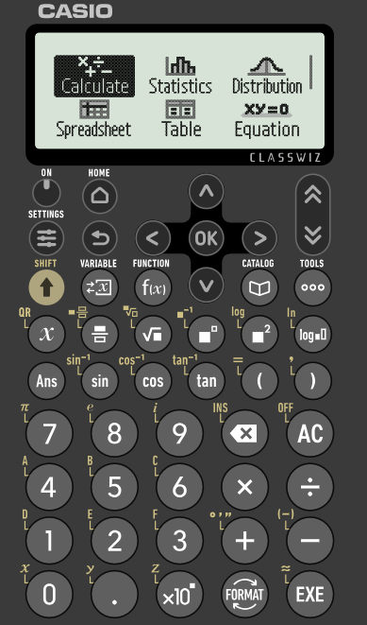
Conversions
In this lesson, we will be using the Casio fx-991CW model.
We will cover how to use this calculator to carry out different calculations.
After switching the calculator on, you will see this screen.

Slide 7
Conversions
You can use the arrow keys to navigate between the options. For now, we are going to focus on ‘Calculate’.
Press the ‘EXE’ button.

Slide 8
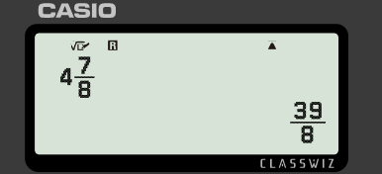

Conversions
Inputting a mixed number into the calculator and pressing ‘EXE’ returns the same value but as an improper fraction.

Slide 9

Conversions
What does inputting an improper fraction into the calculator and pressing ‘EXE’ return?
The same improper fraction
The same value but as a mixed number
The same value but as a decimal

Slide 10




Conversions
So how can I change between improper fractions and mixed numbers?
You need to use the button.
Aisha
Sam

Slide 11
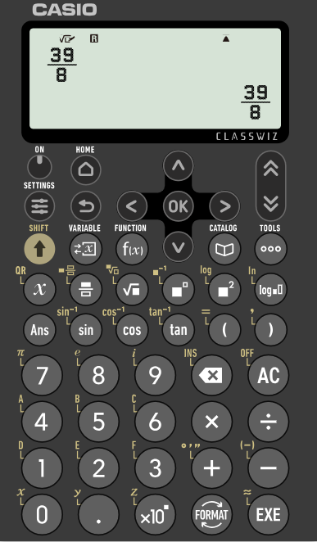
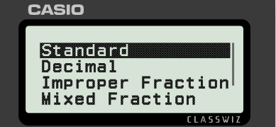
Conversions
When an improper fraction is displayed, you can change the format of the value by pressing the ‘FORMAT’ button.
The value can be displayed as a decimal, improper fraction or mixed fraction.

Slide 12

Conversions
Using your calculator, select the correct equivalent decimal form for
25.94237096
25.94236269
25.94230769

Slide 13
Conversions
Is there more that my calculator can convert?
Yes! You can also convert with time.
Aisha
Sam

Slide 14
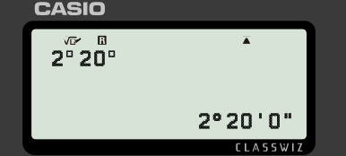


Conversions
Change 2 hours and 20 mins into hours.
Pressing the ‘SHIFT’ button, followed by the ‘+’ allows us to write in the form ‘hour, minute, second’.

Slide 15
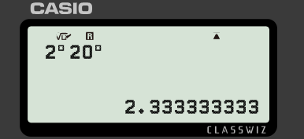

Conversions
Change 2 hours and 20 mins into hours.
Pressing the ‘FORMAT’ key allows you to display the time in different ways.

Slide 16
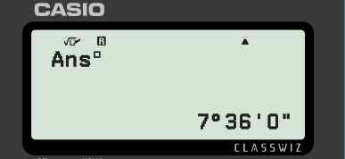
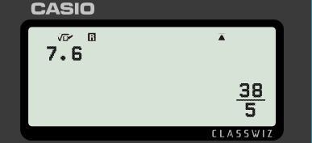

Conversions
A value in hours can be converted into hours, minutes and seconds.
Pressing the ‘SHIFT’ button, followed by the ‘+’ converts to the form ‘hour, minute, second’.
7.6 hours = 7 hours and 36 minutes (0 seconds)

Slide 17
Conversions
3.875 hours is equivalent to what time?
3 hours, 8 minutes and 8 seconds
3 hours, 45 minutes and 8 seconds
3 hours, 52 minutes and 30 seconds

Slide 18
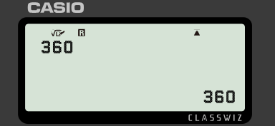

Conversions
Numbers can be written in prime factor form e.g. 49 = 7² and 124 = 2² × 31
Express 360 in prime factor form.

Slide 19
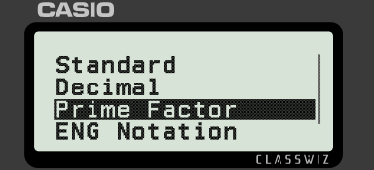
Conversions
Press ‘FORMAT’ and select ‘Prime Factor’.
Express 360 in prime factor form.

Slide 20
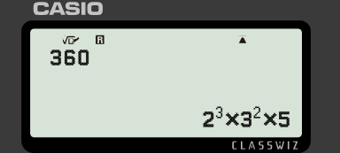
Conversions
Pressing ‘EXE’ gives the number in prime factor form.
Express 360 in prime factor form.

Slide 21
Conversions
Select the missing number: 10 375 750 = 2 × 5³ × 7 × 11²
2
3
4

Slide 22
Conversions
1) Convert the following times to hours.
a) 1 hour and 15 mins
b) 2 hours, 20 mins and 20 secs
c) 4 hours, 15 mins and 16 secs

Slide 23
Conversions
2) Convert the following number of hours to hours, minutes and seconds.
a) 7.25
b) 3.7
c) 7.42
d) 3.63

Slide 24
Conversions
3) Fill in the gaps.
a) 121 = 11²
b) 5500 = 2 × ³ × 11
c) 384 = 2⁷ × 3
d) 351 = 3 × × 13

Slide 25
Conversions
1) Convert the following times to hours.
a) 1 hour and 15 mins = 1.25
b) 2 hours, 20 mins and 20 secs = 2.338
c) 4 hours, 15 mins and 16 secs = 4.254
.
.

Slide 26
Conversions
2) Convert the following number of hours to hours, minutes and seconds.
a) 7.25 = 7 hours and 15 minutes
b) 3.7 = 3 hours and 42 minutes
c) 7.42 = 7 hours, 25 minutes and 12 seconds
d) 3.63 = 3 hours, 37 minutes and 48 seconds

Slide 27
Conversions
3) Fill in the gaps.
a) 121 = 11²
b) 5500 = 2 × ³ × 11
c) 384 = 2 × 3
d) 351 = 3 × ? × 13
The value represented by the question marks should equal 1.
This can be done by having a base of 1 and any exponent or by having any base and an exponent of 0.
2
5
7
1
3
?

Slide 28
Using the fx-991CW for number and algebra
Conversions
Solving linear equations
Solving polynomials

Slide 29
Solving linear equations
So what else can my calculator do?
It can solve some types of equations.
Aisha
Sam

Slide 30
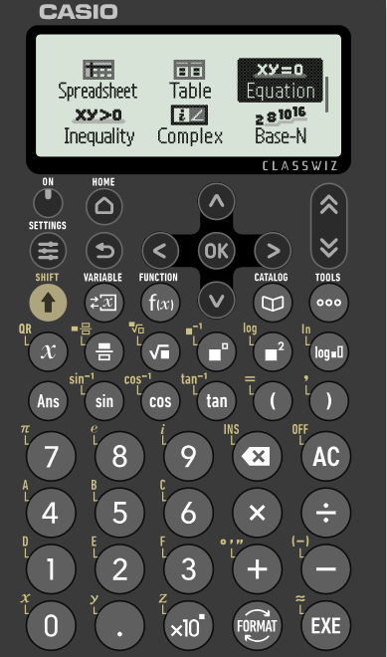
Solving linear equations
From the ‘HOME’ screen, you can navigate down to see more options.
We are going to look at both ‘Equation’ and ‘Inequality’.
We will start with ‘Equation’.

Slide 31

Solving linear equations
Solve the equation 9x − 7 = 25
I already know how to do this! The answer is
Is Aisha correct?
We can check by:
rearranging and solving
using the calculator
Aisha

Slide 32
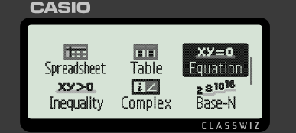
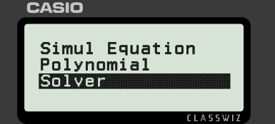
Solving linear equations
Solve the equation 9x − 7 = 25
From the home menu, select ‘Equation’ and then navigate to ‘Solver’.

Slide 33
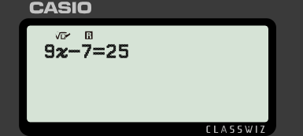


Solving linear equations
Solve the equation 9x − 7 = 25
To input the equation, we use the button to represent the variable and the ‘=’ sign that is above the left parenthesis.

Slide 34
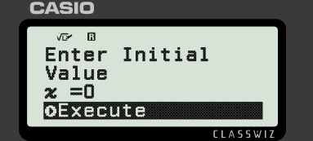
Solving linear equations
Solve the equation 9x − 7 = 25
Press ‘EXE’. Navigate to the ‘Execute’ option and press ‘EXE’.

Slide 35
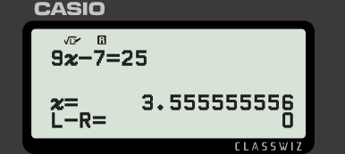
Solving linear equations
Solve the equation 9x − 7 = 25
The value for the variable is now displayed.
This mode can be used to solve linear equations with one variable.

Slide 36

Solving linear equations
The ‘Solver’ mode can solve this equation, without the need for rearrangement.
Try it out for yourself. You should find that x = 8

Slide 37
Solving linear equations
The ‘Solver’ mode can solve this equation, without the need for rearrangement: 4 = 5y + 19
Try it out for yourself. You will need to type x instead of y into your calculator. You should find that y = −3

Slide 38
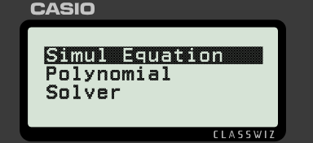
Solving linear equations
Our calculator can also solve pairs of linear simultaneous equations.
From the home menu, select ‘Equation’ and then navigate to ‘Simul Equation’. Then select ‘2 Unknowns’.

Slide 39
Solving linear equations
Your calculator will only accept equations in the form ax + by = c so it may be necessary to rearrange before inputting.
w + h + 8 = 0
x + y = −8
h = 4w − 17
4x − y = 17
The calculator uses x and y so it is important that you know which variable x is representing and which variable y is representing.

Slide 40
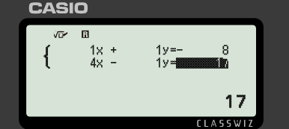
Solving linear equations
Your calculator will only accept equations in the form ax + by = c so it may be necessary to rearrange before inputting.
w + h + 8 = 0
x + y = −8
h = 4w − 17
4x − y = 17
Be careful with any negative values.

Slide 41
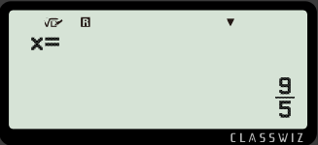
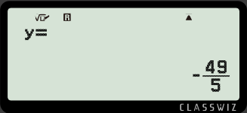
Solving linear equations
Your calculator will only accept equations in the form ax + by = c so it may be necessary to rearrange before inputting.
w + h + 8 = 0
x + y = −8
h = 4w − 17
4x − y = 17
Pressing ‘EXE’ gives one value and pressing ‘EXE’ again shows the second value.
We can interpret this as w = 1.8 and h = −9.8

Slide 42
Solving linear equations
You can enter any pair of simultaneous equations into your calculator without needing to rearrange.
Equations must be in the form ax + by = c
Sometimes it is necessary to rearrange first.

Slide 43
Solving linear equations
1) Solve the following without using a calculator and then check your answers using the calculator.
Which way of solving is faster?
a) b) c)

Slide 44
Solving linear equations
2) Solve the following pairs of simultaneous equations using your calculator.
a) b)
2a + 3b = 1
2b + a = 8
−a + 4b = 8
2b + 3 = 7a

Slide 45

Solving linear equations
1) Solve the following without using a calculator and then check your answers using the calculator.
Which way of solving is faster?
a) b) c)
x = 36
x = 2
y = −3.47058…

Slide 46
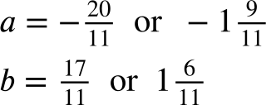
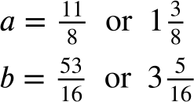
Solving linear equations
2) Solve the following pairs of simultaneous equations using your calculator.
a) b)
2a + 3b = 1
2b + a = 8
−a + 4b = 8
2b + 3 = 7a

Slide 47
Using the fx-991CW for number and algebra
Conversions
Solving linear equations
Solving polynomials

Slide 48
Solving polynomials
So my calculator can solve linear equations, including simultaneous ones. Anything else?
It can solve polynomial equations. It can also solve quadratic inequalities.
Aisha
Sam

Slide 49
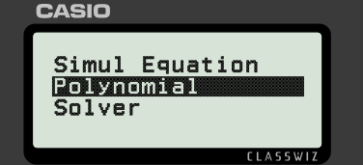
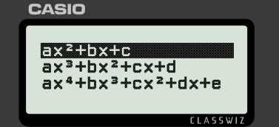
Solving polynomials
From the home menu, select ‘Equation’ and then navigate and select ‘Polynomial’. Choose the general form for the polynomial you want to solve.

Slide 50
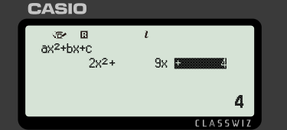
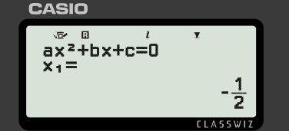
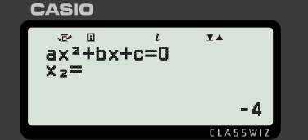
Solving polynomials
Solve 2x² + 9x + 4 = 0
Your calculator will only accept equations in the form ax² + bx + c = 0 so it may be necessary to rearrange first.
Press ‘EXE’ to solve. Press ‘EXE’ again to see the second solution.

Slide 51
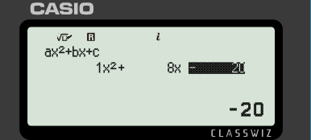
Solving polynomials
Use your calculator to find the solution(s) to x² + 8x − 20 = 0
x = 2
x = −10

Slide 52
Solving polynomials
Solve x² + 8x − 20 < 0
I’ll use my calculator to find the roots and then work out which way round the inequality signs should be.
You could do that or…
Aisha
Sam

Slide 53
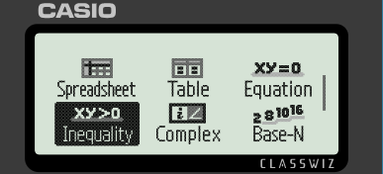
Solving polynomials
From the home menu, select ‘Inequality’. Choose the general form for the polynomial you want to solve.

Slide 54
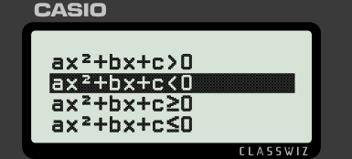
Solving polynomials
Solve x² + 8x − 20 < 0
Make sure you choose the correct inequality.

Slide 55
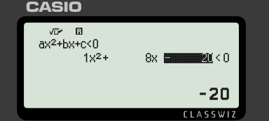
Solving polynomials
Use your calculator to find the solution(s) to x² + 8x − 20 < 0
−10 < x < 2

Slide 56
Solving polynomials
1) Solve these quadratic inequalities (to 2 d.p. if appropriate).
a) −x² − 8x + 20 ≥ 0
b) x² + 8x − 19 < 0
c) x² + 6x + 8 < 3
d) 5x² − x + 5 > 3x² − 10x − 2

Slide 57

Solving polynomials
1) Solve these quadratic inequalities (to 2 d.p. if appropriate).
a) −x² − 8x + 20 ≥ 0 −10 ≤ x ≤ 2
b) x² + 8x − 19 < 0 −9.92 < x < 1.92
c) x² + 6x + 8 < 3 −5 < x < −1
d) 5x² − x + 5 > 3x² − 10x − 2

Slide 58
Using the fx-991CW for number and algebra
Some calculators can perform more than just basic calculations.
The fx-991CW can convert between different formats for values.
The fx-991CW can solve equations numerically.

Slide 59

© Oak National Academy 2025.
Produced in partnership with Casio and Mathematics in Education and Industry.
Licensed on the Open Government Licence v3.0, except where otherwise stated. See Oak terms and conditions.

